Slide 1


Creative Short Name of the Innovation
(Feel free to include the logo if you have one)
Tip: Keep it visually clean with your logo or a key image.
Note: Remember this is just a template
Department of Computer Science, COCIS
Makerere University
Lecturer: Ggaliwango Marvin
- Group Number
- Group Name (if any)
- Names & University Registration Numbers of Group Members

Slide 2
The Problem
Purpose: Define the key problem you are solving.
Content:
  What’s the problem?
  Who is affected?
  Why does it matter?
  Include a relatable stat or story (especially local context).
Tip: Keep it visually clean & not cluttered.

Slide 3
The Solution
Purpose: Explain how your innovation solves the problem.
Content:
  Describe your AI-powered or intelligent system solution.
  Show how it works differently or better than existing approaches.
  Mention your key features or unique value proposition.
Tip: Keep it visually clean & not cluttered.

Slide 4
Technology & Architecture
Purpose: Highlight the technical foundation.
Content:
  Technologies used (e.g., Python, TensorFlow, Flutter, Firebase, etc.).
  Simple architecture or workflow diagram.
  Any AI models, APIs, or data sources used.
Tip: Keep the visuals simple; focus on the “intelligence” in your system.ered.

Slide 5
Business Model
Purpose: Show how your project can sustain itself or scale.
Content:
  Who pays or benefits? (users, partners, organizations)
  Revenue stream or value exchange (subscription, freemium, sponsorship, etc.)
  Any potential partners or early adopters identified.
Tip: Keep the visuals simple; focus on the “intelligence” in your system.ered.

Slide 6
Future Plans & The Ask
Purpose: End strong with your next steps.
Content:
  What do you need next? (mentorship, funding, incubation, users)
  Your vision for growth or scaling.
  One powerful closing statement or quote.
Tip: Avoid long videos — one GIF, image, or short clip or simple walkthrough is enough.

Slide 7
Demo / Prototype
Purpose: Show proof of execution or working prototype.
Content:
  Screenshot or live demo of your app/system.
  Key functionality or user flow (brief and visual).
  What stage you’re at (prototype, MVP, beta, etc.).
Tip: Keep the visuals simple; focus on the “intelligence” in your system.

Slide 8
Design & Delivery Guidelines
(Please remove all Notes, tips & irrelevant slides)
Content:
  Time limit: 5 minutes per team (strict).
  Design: Consistent theme (blue/white or your project colors).
  Text: Use minimal text — 5 bullet points max per slide.
  Fonts: Use readable sans-serif fonts (e.g., Poppins, Open Sans).
  Visuals: Diagrams, icons, screenshots — not paragraphs.
  Teamwork: 1–2 members can share the pitch roles (intro, tech, business).
  Keep it visually appealing 🚀
REMOVE ME FROM YOUR PRODUCTION SLIDES

Slide 9
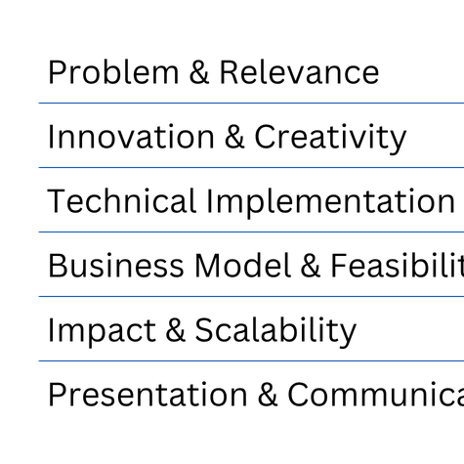
Judging Criteria
Purpose: End strong with your next steps.
REMOVE ME FROM YOUR PRODUCTION SLIDES

Slide 10
Thank You!
  Open the floor for questions.
  Include contact detailsor socials if relevant.

